Slide 1
Resolving the Billion Dollar Mistake January 2016
Notes:
1

Slide 2
Content
The Billion-dollar Mistake
Functional Programming
Refactoring Away from Exceptions
Railway-oriented Programming

Slide 3
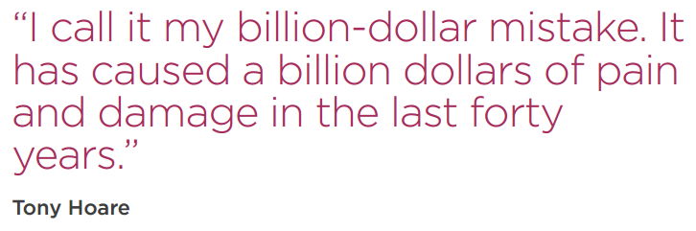
The Billion-dollar Mistake

Slide 4
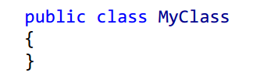
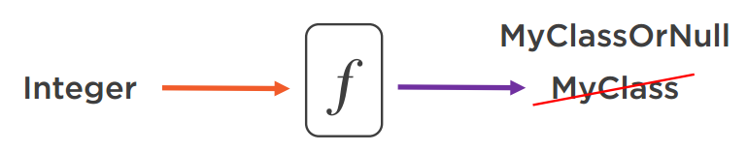
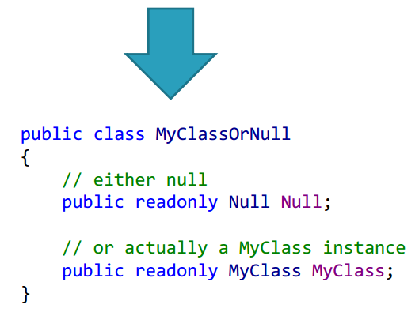


The Billion-dollar Mistake

Slide 5
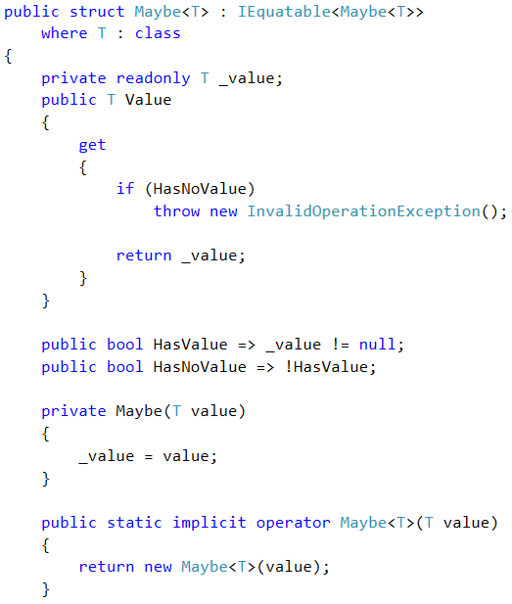

The Billion-dollar Mistake
Introducing the Maybe<T> struct

Slide 6
The Billion-dollar Mistake
Example

Slide 7



Functional Programming

Slide 8
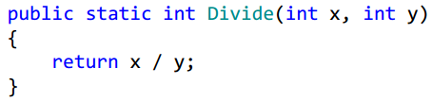
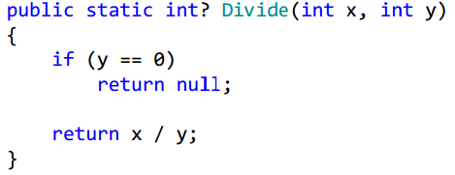
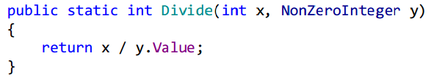


Functional Programming
Outcomes:
Result of the division (int)
Throw an exception

Slide 9
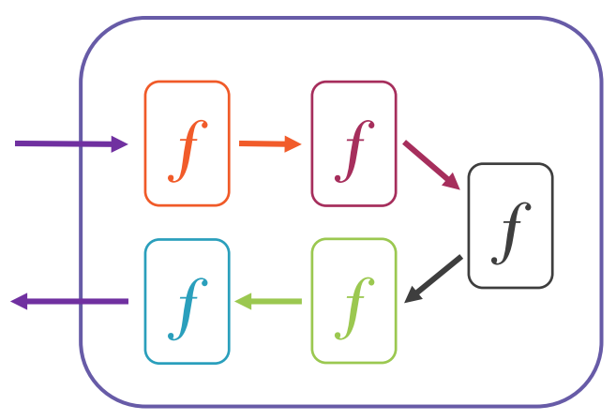
Functional Programming
Benefits
Reduce code complexity
Composable
Easier to unit test
Drawbacks
More effort during object creation
Difficult to understand and follow all the principles at first glance

Slide 10
Functional Programming
Example

Slide 11
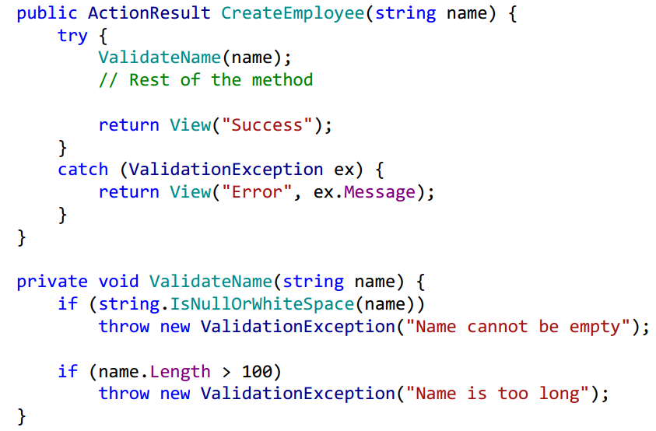
Refactoring Away from Exceptions

Slide 12
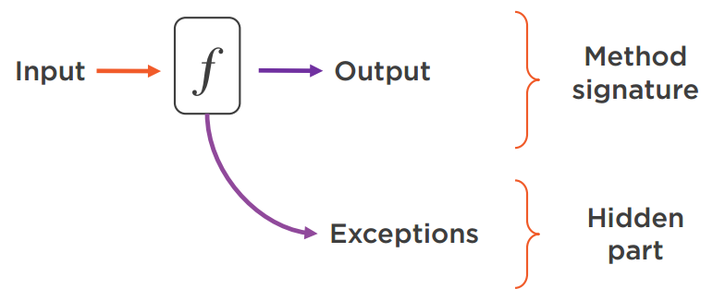



Refactoring Away from Exceptions

Slide 13
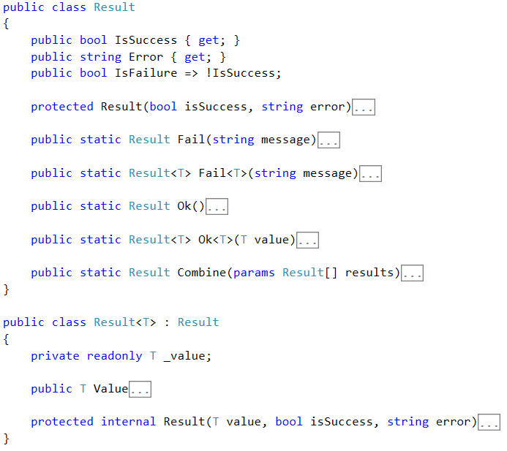
Refactoring Away from Exceptions
Introducing the Result class

Slide 14
Refactoring Away from Exceptions
Example

Slide 15
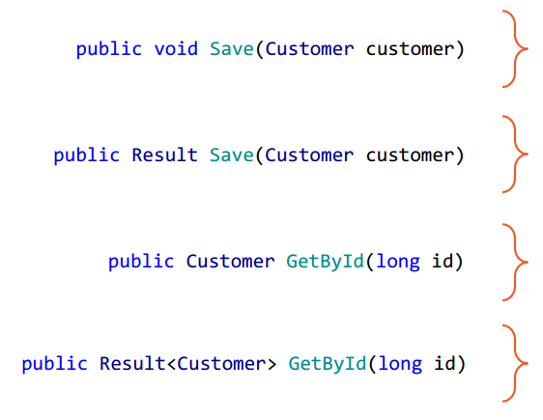




Refactoring Away from Exceptions
Introducing the Result class

Slide 16
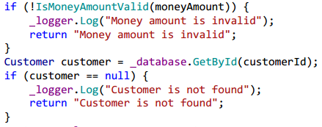
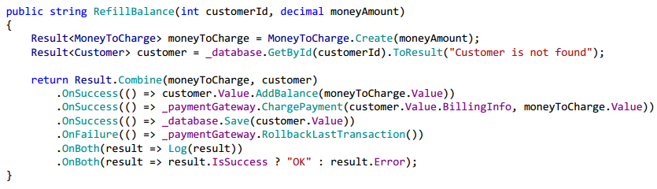
Railway-oriented Programming

Slide 17
Railway-oriented Programming
Example

Slide 18
Resolving the Billion Dollar Mistake
Thank You

Slide 19
References
Vladimir Khorikov - Applying Functional Principles in C#
Tony Hoare - Null References: The Billion Dollar Mistake
Scott Wlaschin - Railway-oriented Programming

